Slide 1

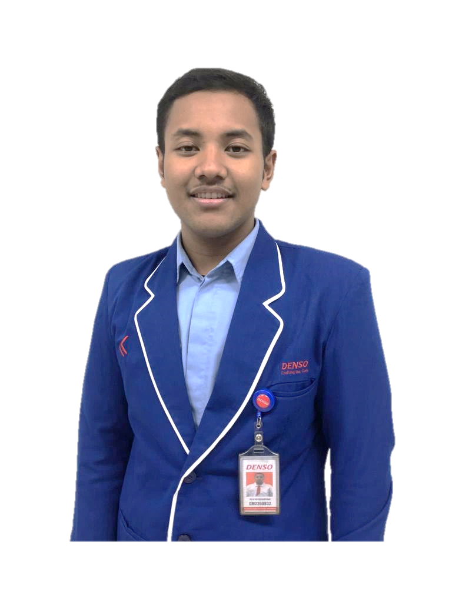



SMART HRGA SYSTEM
SHS
REZA HUSEN ANUGRAH
HRGA TEAM
ANDI RAMLI HIDAYAT
DM2260932 - BF23 Power Window Assy
Ms. Elizaebeth
Mr. Faisal
Mr. Irfan
Mr. Mulyanto
Mr. Syafrudin
DM2260927- BF43 FRWP GP M&L Assy
Macros & Power Automate Developer
Microsoft List & Power Apps Developer
PT. DENSO MANUFACTURING INDONESIA
DX Project KOSEN #10
System Development
@ DENSO CORPORATION All Rights Reserved.

Slide 2



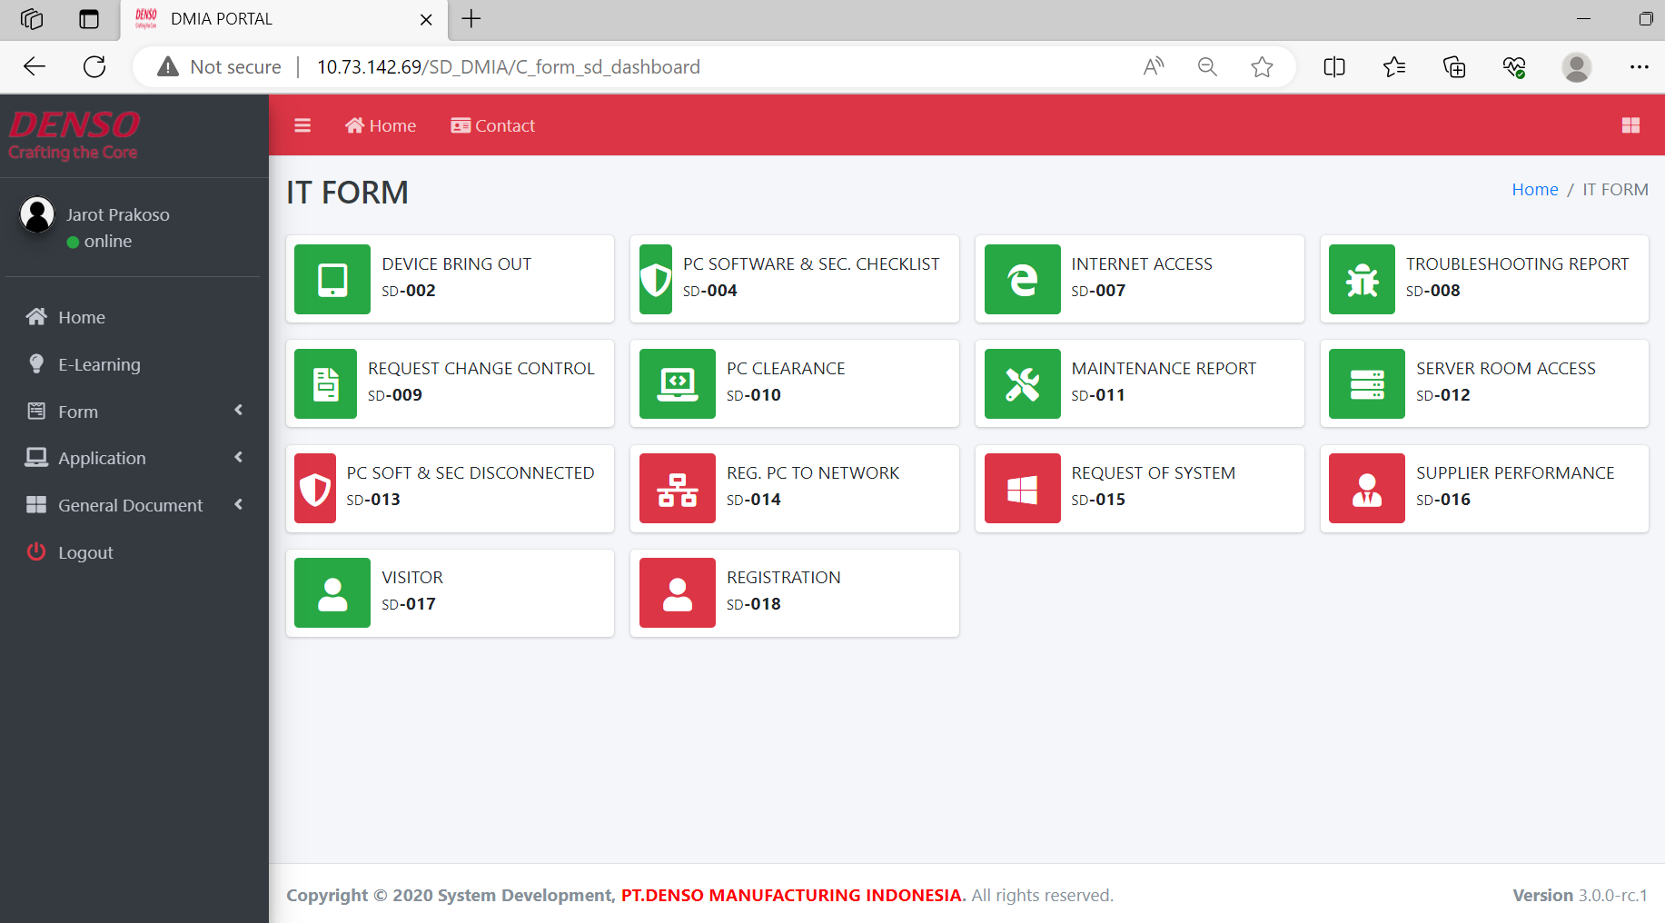










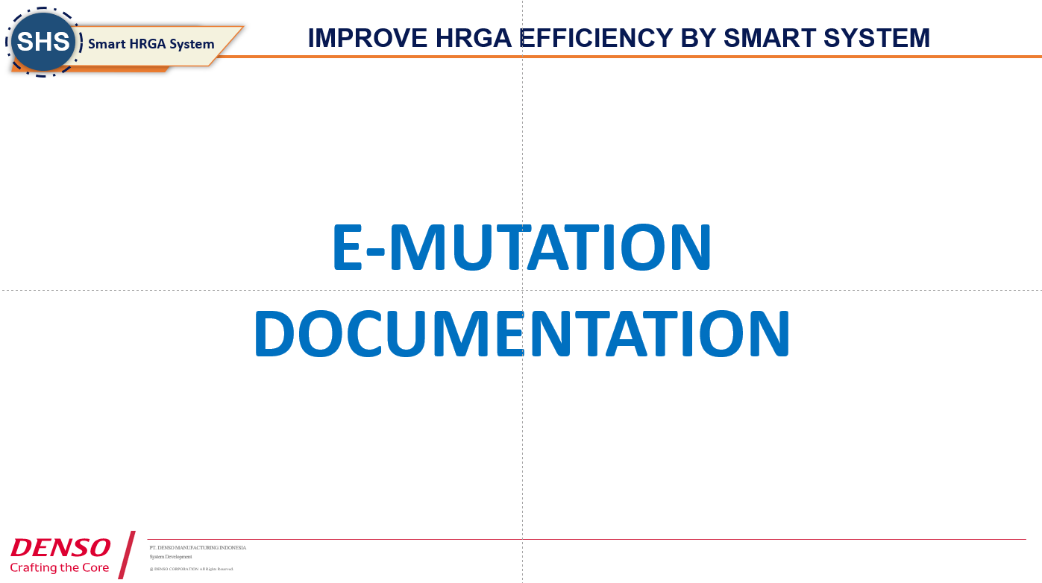
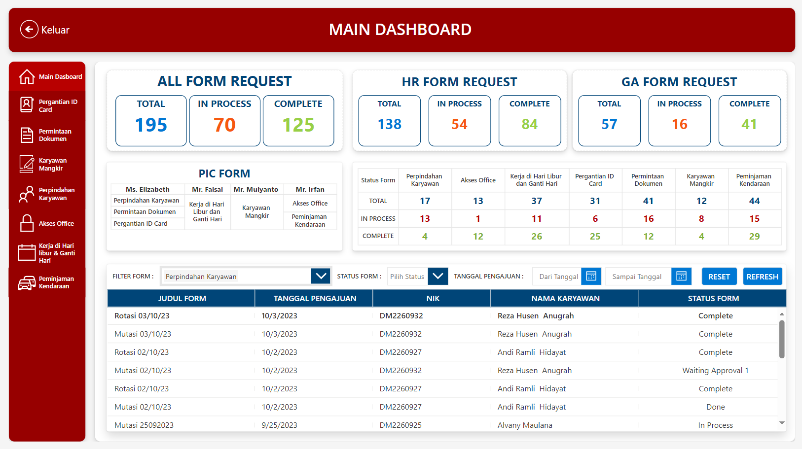



IMPROVE HRGA EFFICIENCY BY SMART SYSTEM
WAY OF THINGKING
Efficiency Operation with Digital System
SHS ?
One Stop Service
PURPOSE
Create Digital System to ELIMINATE LOST TIME and PAPER USAGE
Create Digital System to increase Accuracy data and ELIMINATE CORRECTION TIME
Create system that LOW/ZERO COST and INDEPENDENT from Vendor and Easy to Maintain by User (Citizen Developer)
GOALS
100%
Digitalize System at HRGA
All Form can be accessed in one Page ( DMIA PORTAL )
TARGET
CURRENT CONDITION
LOST TIME
Digitalize 8 form
saving man hour 73 Hours / month and Reduce paper 3 RIM paper
1 Visualization Dashboard for Easy Track and Monitoring
Zero Cost Digitalize system using Power Platform
240 Minutes
Walking Approval all form
80 Minutes
Paper preparation
All form
I
16 FORM
are still paper-based
HRGA OPERATION
CLICK DETAIL
Difficult Tracking and Monitoring Employee Request
6 RIM/ year
Spent Paper
ACTIVITIES
Create :
E-Vehicle Lending
E-Change Day
E-Document Request
E-Employee Absence
E-Holiday Work Request
E-ID Card Replacement
ACCURACY DATA
Some form need accuracy of data (ex: Attendance, etc) to match with payroll
Many Payroll miscalculation
II
7. E-Mutation 8. E-Access
NEED 5 DAYS FOR CORRECTION
Create Documentation
(manual book)
Create Visualization
HIGH COST and DEPENDENT to vendor for Create and Maintain
25 Million
To digitize 1 new form
III
2,5 Million
To pay 1 man days for maintain
14 Aug – 24 Aug
24 Aug – 24 Sept
25 Sept – 13 Oct
6, 19, 24 Oct
25 Oct
CONCEPT
DEVELOPMENT
USER ACCEPTED TEST
DEPARTMENT HEAD REVIEW
PRESENTATION
PT. DENSO MANUFACTURING INDONESIA
1/4
DIGITIZING SYSTEM TO IMPROVE EFFICIENCY IN AN EASY, FAST, AND CHEAP WAY
System Development
@ DENSO CORPORATION All Rights Reserved.
Notes:
IMPROVE HR EFFICIENCY BY SMART SYSTEM
WITH SMART HRGA SYSTEM WE CAN make OPERATION IN HRGA WILL BE MORE EFFICIENCY, WHY?
LET’S SEE CURRENT CONDITION
In HRGA there's several form, like request id card replacement, vehicle borrowing form request etc, some form that still paper based have manual process, so this make employee as a requester have loss time, there is walking approval arrange 20 minutes and prepare paper arrange 5 minutes.
And until now in HRGA 16 Form are still paper based, its mean spent 25920 paper yearly.
HRGA also difficult to track and monitoring form because there are paper
And then if they are want to Digitalize form they must pay vendor 25 million for 1 form to Create and Maintain
So with this condition SHS purpose to
Create Digital System to Eliminate User Lost Time
Create Digital System to Improve HR Efficiency
Create Visualization to Track and Monitoring Form
Create system that Low-Cost Development without Vendor and Easy to Maintain for Citizen Developer
and then our targets in 2 months is
1-4
And following of the target there is our activity

Slide 3
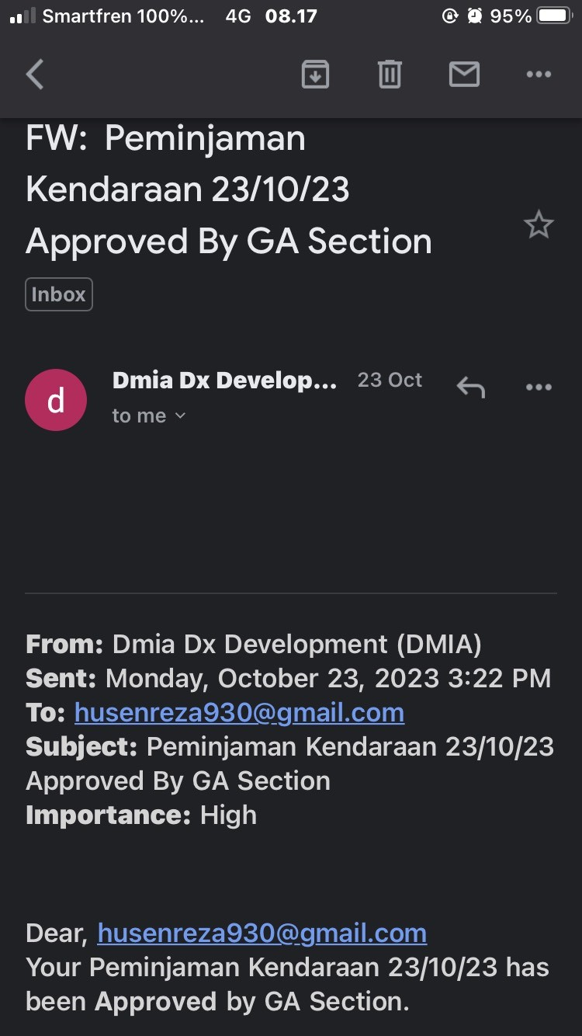



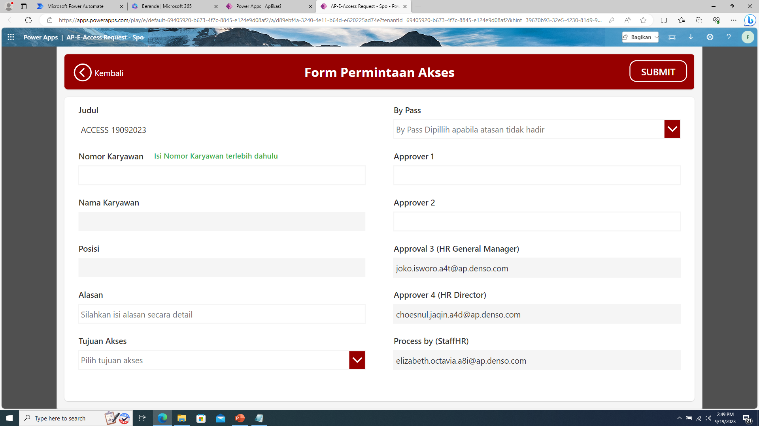

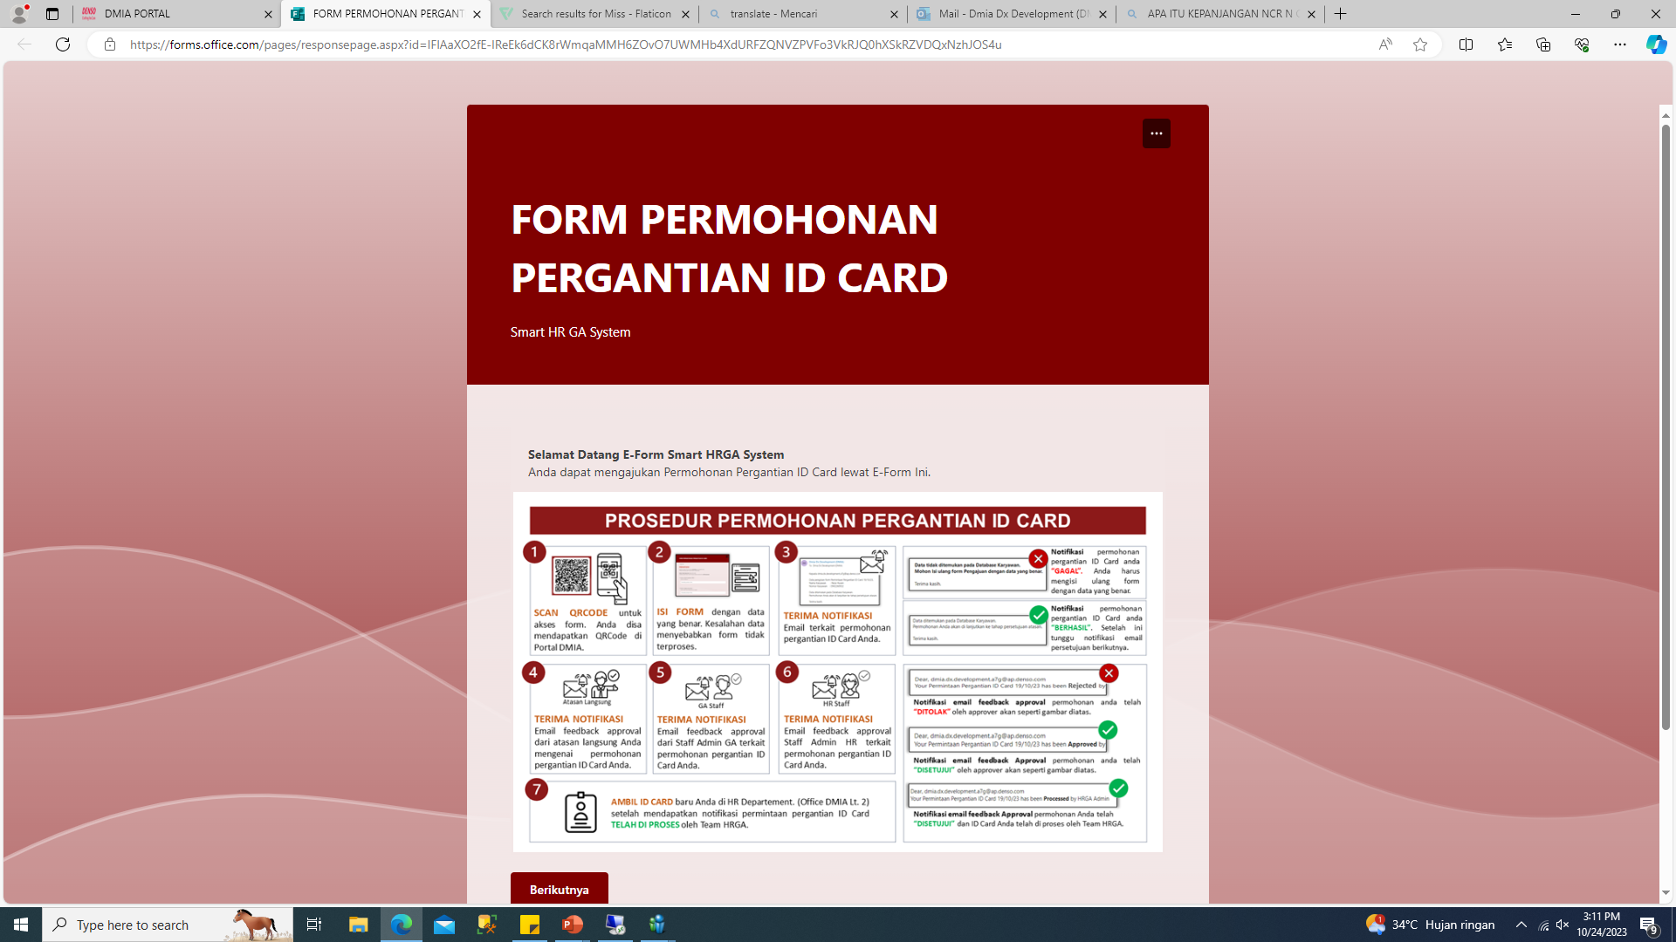


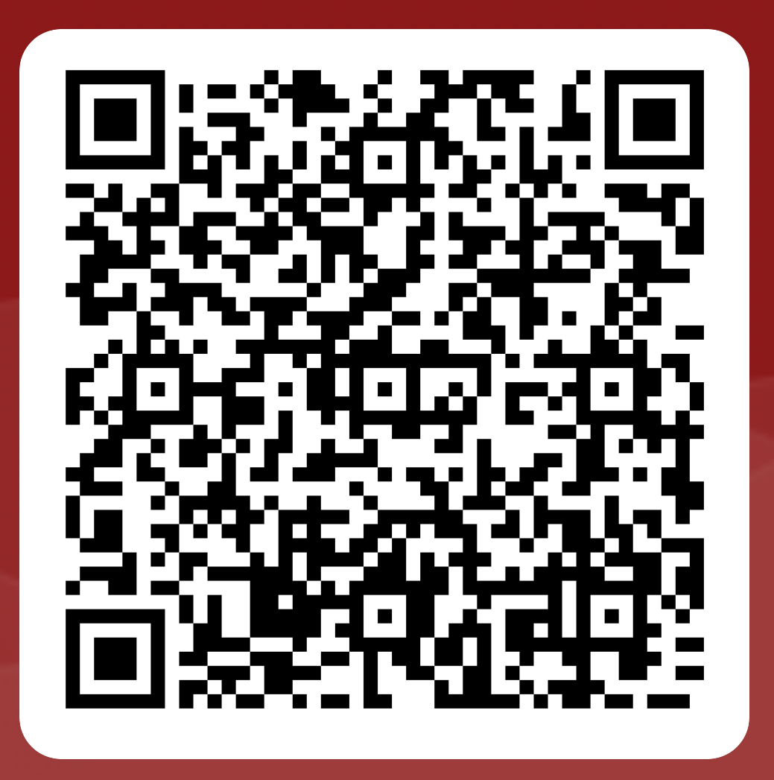
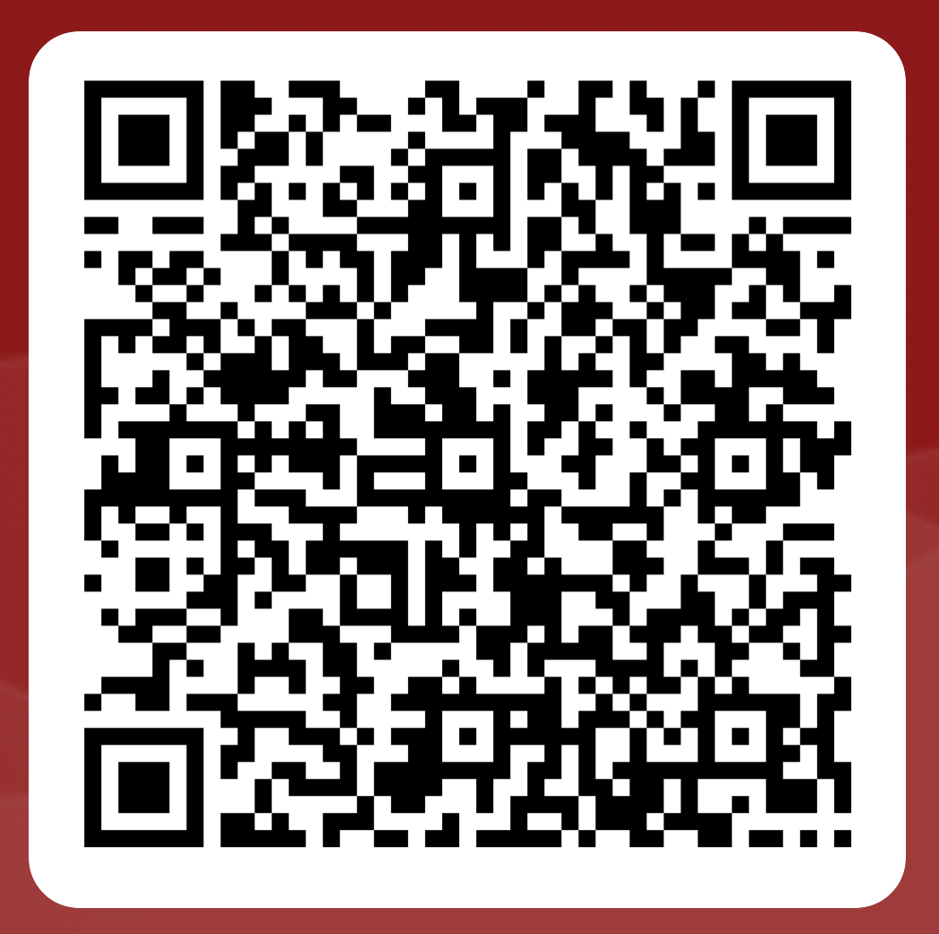
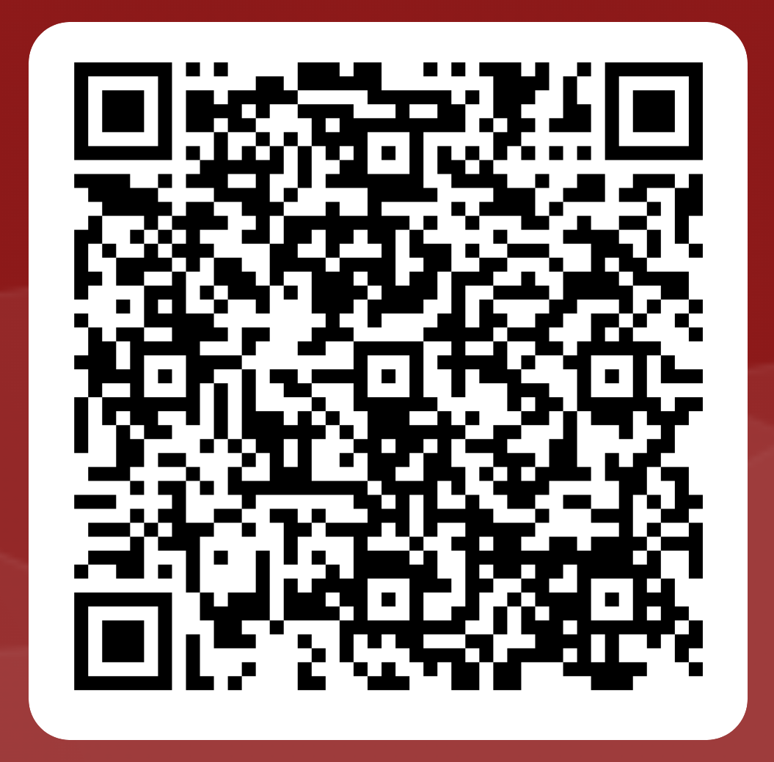
DETAIL SYSTEM
FLOW PROCESS
ADVANTAGES FORM
ADVANTAGES FORM
PAPER FORM
NOTIFICATION
All employee as a requester get notification from their Personal Account Mail
Spent Paper 25 RIM/year
Input data Form on paper
Requester
Requester can know progress form request
Admin
(Section)
Admin
(HRGA)
Notification
Processing
& Recap
By Office Phone
10 minutes walking time
Complete
AUTO FILL INPUT
Request Approval
Approver
For Power Apps application, just input employee ID, Because connected to local database.
Speed up Input Form and Avoid error input
Paper Form can make More Costs For Company
DIGTAL FORM
Zero Paper Usage
FLEXIBLE ACCESS
Input data Form on Device
Requester
Microsoft Form Can Accessed anytime and anywhere.
Microsoft Teams can Approved Requested Form Anywhere and Anytime
Admin
(HRGA)
Notification
SHS
Processing
By Personal Mail
0 Minute Walking Time
Request Approval on Mail
Complete
Approver
With Digital Form can Reduce Man Hour & Paper Usage
Just scan QR CODE for access MS Form
PT. DENSO MANUFACTURING INDONESIA
2/4
DIGITIZING SYSTEM TO IMPROVE EFFICIENCY IN AN EASY, FAST, AND CHEAP WAY
System Development
@ DENSO CORPORATION All Rights Reserved.
Notes:
detail system, every form have same flow there is

Slide 4
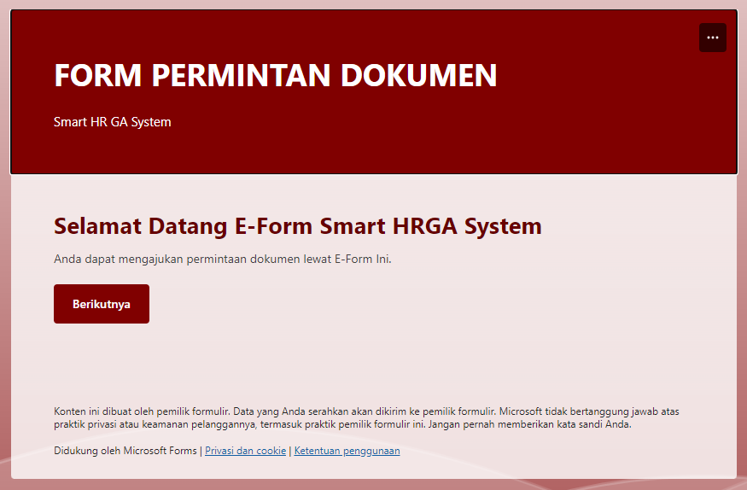
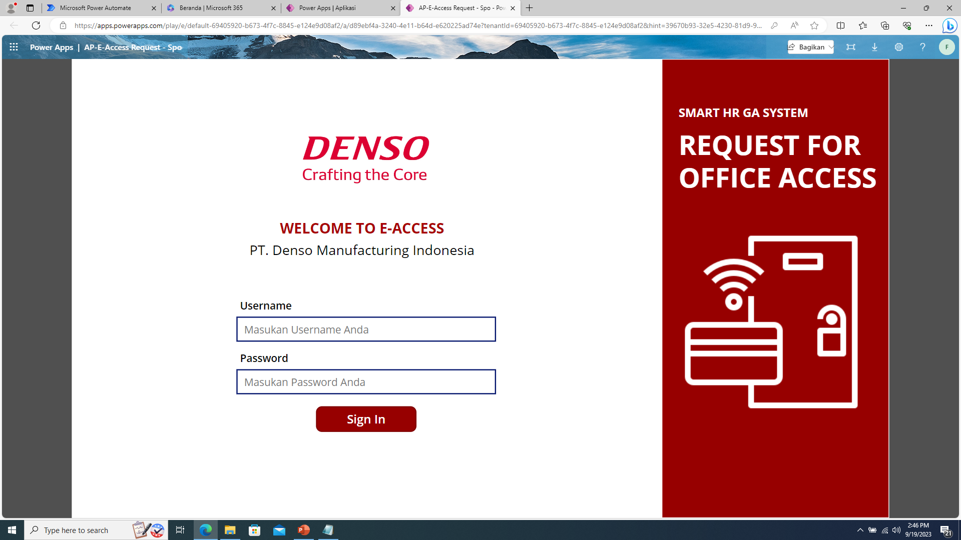

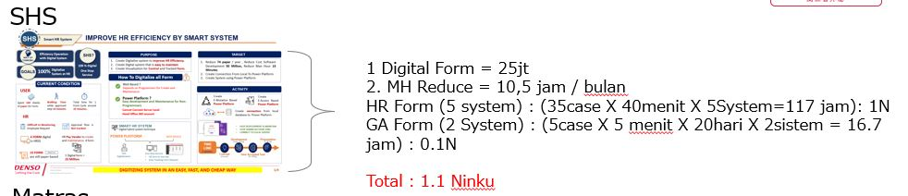

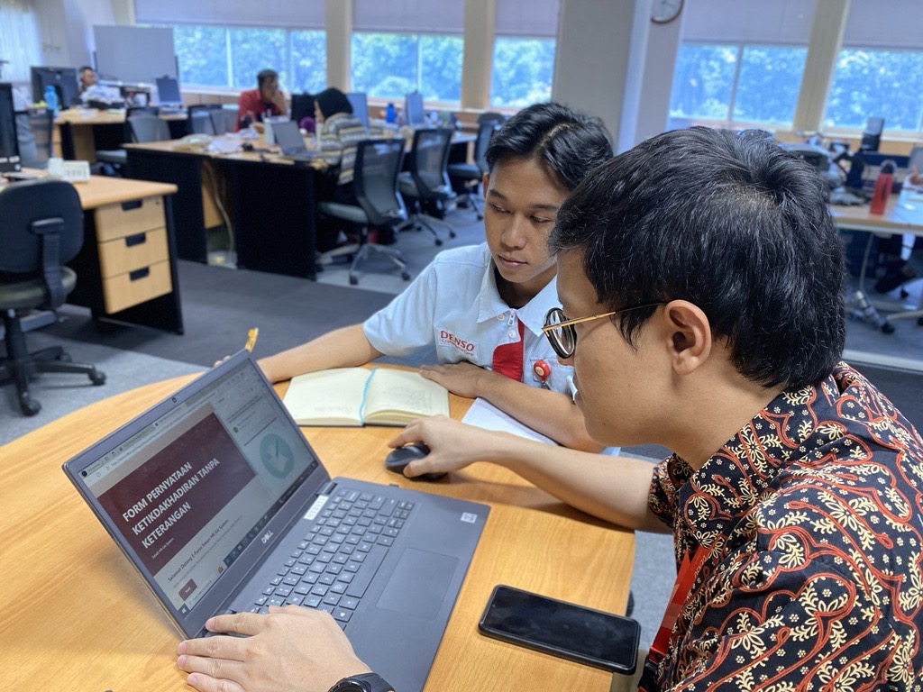
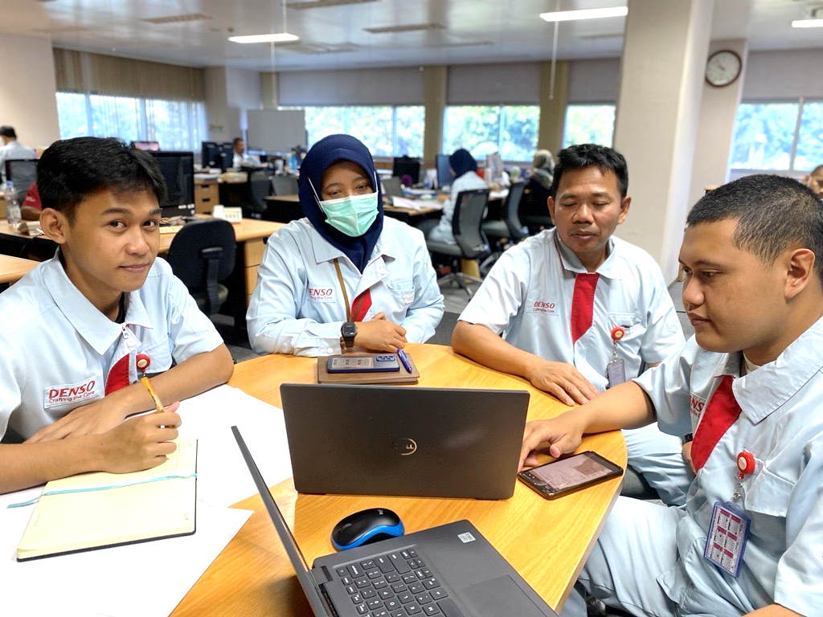
RESULT
APPLICATION
ACTUAL BENEFITS
5 MS FORM
1
Reduce Paper Usage
E-Document Request
E-ID Card Replacement
E-SIM Registrations
E-Vehicle Lending
E-Absence Employee
8 Form have been Digitalize
= Arrange 3 RIM / year
PAPER FORM
DIGITAL FORM
4 POWER APPS
2
Reduce Cost Software Development
0Rp
E-Mutation
E-Office Access
E-Day Change & Holiday Request
E-Vehicle Lending Admin
Pays vendor 25 million for 1 one application
8 form x 25 million = 200 million
Saving Money 200 million
1 VISUALIZATION POWER APPS -> Easy Monitoring Progress status
Create 8 Forms Costs
=
3
Reduce Man Hours
BEFORE E-FORM
Preparing the paper form
5 minutes
Fill Form by writing
5 minutes
Admin go to approver
20 minutes.
Recap Time
5 minutes.
30 minutes
IMPLEMENTATION
AFTER
E-FORM
Preparing
E- form
2 minutes.
AutoFill Form
system
1 minutes.
System Approval by email
Recap in
System
3 minutes
UAT (User Acceptance Test)
Saving man hours average 73 hours for one month
4
Easier to Control Progress Status Request
Admin can know updated progress about Request Form by Dashboard SHS
PT. DENSO MANUFACTURING INDONESIA
REDUCE PAPER, COST, SAVING MAN HOURS & START CITIZEN DEVELOPER
3/4
System Development
@ DENSO CORPORATION All Rights Reserved.

Slide 5






LEARNING POINT
SKILLS MATRIX
THE NEXT PLANNING FOR SMART HRGA SYSTEM
Employee Without 365 Account + Attachment
WEB BASE
Independent transportation allowance registration form
Salary Correction Form
Work Permit Outside Form
Permit Work Leave Form
Training Report Form
Own Motor Vehicle Form
Claims For Official Travel Expenses by Private Vehicle
Registration Of Independent Transportation Allowance Form
LEARNING OBTAINED
Dare to try new Things
Current Analysis + PDCA is must to make a proper planning and targets before do something.
Always think positively and believe that we can break our limits.
Always Communicate to report and discussion at every step.
Specification Analysis is Key
PT. DENSO MANUFACTURING INDONESIA
LEARN SOMETHING NEW TO IMPORVE SKILL
4/4
System Development
@ DENSO CORPORATION All Rights Reserved.

Slide 6



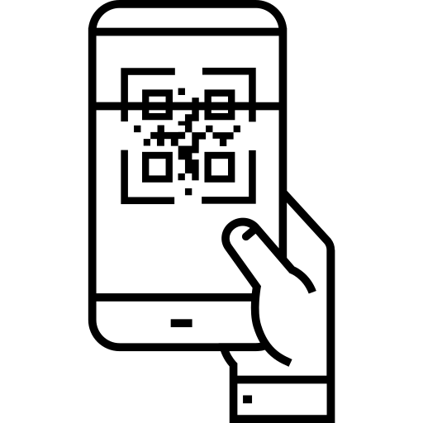


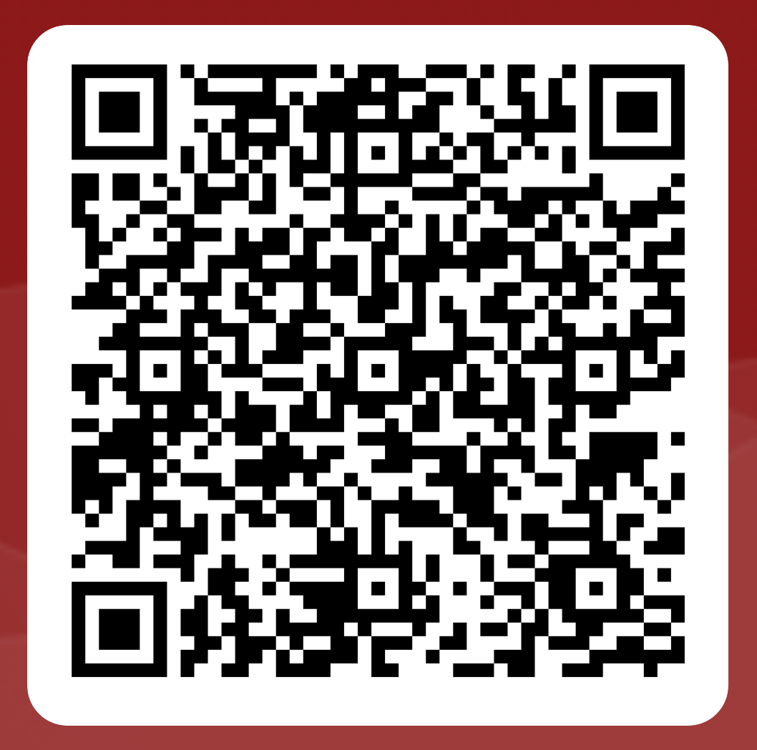
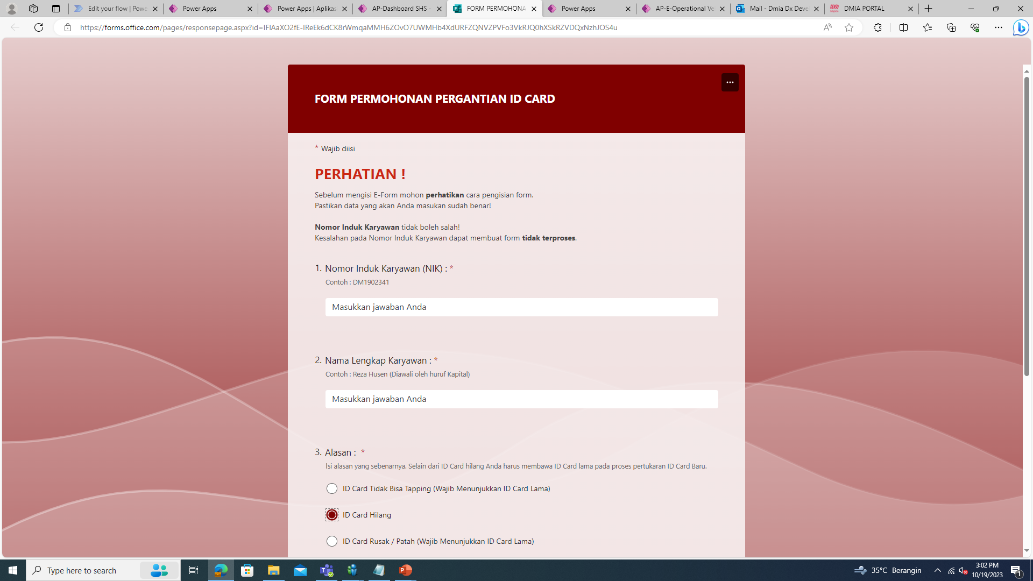
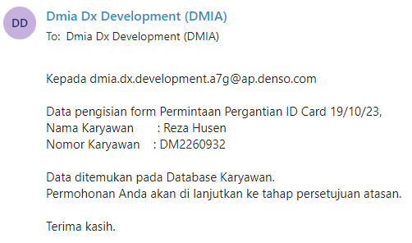
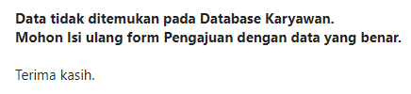









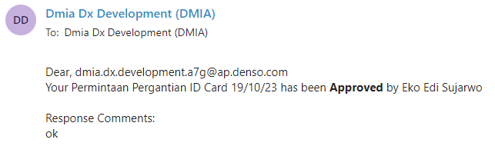


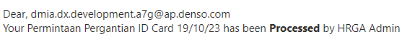
PROSEDUR PERMOHONAN PERGANTIAN ID CARD
Notifikasi permohonan pergantian ID Card anda “GAGAL”. Anda harus mengisi ulang form dengan data yang benar.
SCAN QRCODE untuk akses form. Anda disa mendapatkan QRCode di Portal DMIA.
ISI FORM dengan data yang benar. Kesalahan data menyebabkan form tidak terproses.
TERIMA NOTIFIKASI
Email terkait permohonan pergantian ID Card Anda.
Notifikasi permohonan pergantian ID Card anda “BERHASIL”. Setelah ini tunggu notifikasi email persetujuan berikutnya.
Rejected
Atasan Langsung
GA Staff
HR Staff
Notifikasi email feedback approval permohonan anda telah “DITOLAK” oleh approver akan seperti gambar diatas.
TERIMA NOTIFIKASI
Email feedback approval dari atasan langsung Anda mengenai permohonan pergantian ID Card Anda.
TERIMA NOTIFIKASI
Email feedback approval dari Staff Admin GA terkait permohonan pergantian ID Card Anda.
TERIMA NOTIFIKASI
Email feedback approval Staff Admin HR terkait permohonan pergantian ID Card Anda.
Notifikasi email feedback Approval permohonan anda telah “DISETUJUI” oleh approver akan seperti gambar diatas.
AMBIL ID CARD baru Anda di HR Departement. (Office DMIA Lt. 2) setelah mendapatkan notifikasi permintaan pergantian ID Card TELAH DI PROSES oleh Team HRGA.
Notifikasi email feedback Approval permohonan Anda telah “DISETUJUI” dan ID Card Anda telah di proses oleh Team HRGA.

Slide 7










PROSEDUR PEMINJAMAN KENDARAAN OPERASIONAL
REGISTRASI SIM A.
Daftarkan SIM Anda pada admin section agar dapat mengajukan peminjaman kendaraan operasional.
PENGAJUAN FORM PEMINJAMAN.
Scan QRCode untuk mengisi form peminjaman kendaraan operasional. QRCODE dapat diakses pada Portal DMIA. Pastikan Mengisi form dengan data yang benar.
VALIDASI DATA.
Data Anda dan data SIM pada form pengajuan akan di validasi. Anda akan menerima email notifikasi pengajuan peminjaman kendaraan berhasil atau gagal.
APPROVAL ATASAN.
Anda akan menerima email feedback Atasan 1 (Superior1) dan Atasan 2 (Superior2) Anda, terkait persetujuan peminjaman kendaraan operasional.
APPROVAL DAN PENENTUAN KENDARAAN.
Kendaraan yang di pinjamkan akan di tentukan oleh admin GA Section. Anda akan menerima email feedback terkait persetujuan peminjaman kendaraan.
APPROVAL GA SECTION HEAD.
Anda akan menerima email feedback GA Section Head sekaligus attachment file data peminjaman kendaraan Anda.
SECURITY CEK.
Pergi ke pos security dan Tunjukan file permohonan sebagai bukti peminjaman untuk mendapatkan kunci kendaraan.
KONFIRMASI KEPULANGAN.
Setelah anda Kembali ke perusahan konfirmasi kepulangan anda dengan melapor dan mengembalikan kunci kendaraan ke Security. Security akan menginfomasikan ke Team GA lewat extensi.

Slide 8
SLIDE PENANGGUNG JAWABAN DATA ATAU HITUNG2 AN

Slide 9

RESULT
APPLICATION
ACTUAL BENEFITS
5 MS FORM
1
Reduce Paper Usage
E-Document Request
E-ID Card Replacement
E-SIM Registrations
E-Vehicle Lending
E-Absence Employee
8 Form have been Digitalize
= Arrange 1080 paper / month
PAPER FORM
DIGITAL FORM
4 POWER APPS
E-Mutation
E-Office Access
E-Day Change & Holiday Request
E-Vehicle Lending Admin
2
Reduce Cost Software Development
Pays vendor 25 million for 1 one application
8 form x 25 million = 200 million
1 VISUALIZATION POWER APPS
0Rp
Create 8 Forms Costs
Saving Money 200 million
=
IMPLEMENTATION
UAT (User Acceptance Test)
3
Reduce Man Hours
Saving man hours average 900 minutes for one month
BEFORE E-FORM
Preparing the paper form
5 minutes
Fill Form by writing
5 minutes
Admin go to approver
20 minutes.
30 minutes
AFTER
E-FORM
Preparing
E- form
2 minutes.
AutoFill Form
system
1 minutes.
System Approval by email
3 minutes
REDUCE PAPER, COST, SAVING MAN HOURS & START CITIZEN DEVELOPER
3/4

Slide 10
IMPROVE HRGA EFFICIENCY BY SMART SYSTEM
PURPOSE
TARGET
2
Efficiency Operation with Digital System
SHS?
Create Digital System to Eliminate Lost Time
Create Digital System to Improve HR Efficiency
Create Digital System to Increase Accuracy Data
Create system that Low-Cost Development without Vendor and Easy to Maintain for Citizen Developer
WAY OF
THINKING
Digitalize System at HRGA
Digital
GOALS
100%
One Stop
Service
CURRENT CONDITION
TARGET
1
3
Digitalize 8 form
Reduce paper 1080 paper & saving man hour 540 minutes / month
Easy Track and Monitoring with Visualization
Digitalize system that possible in Power Platform
A
16 Form still paper based (manual process)
Lost Time
HR Operation
160 minutes Walk Approval
40 minutes Prepare Paper
Difficult Tracking and Monitoring
25920 Spent Paper/ Year
ACTIVITY
Some form need Accuracy of Data to match with Payroll
4
B
Employee Absence
Change Day
Holiday Request
ID Card
Create :
E-Vehicle Lending
E-Change Day
E-Document Request
E-Employee Absence
E-Holiday Work Request
E-ID Card Replacement
C
Digitalization depend to Vendor for Create and Maintain
Improve : 7. E-Mutation 8. E-Access
Create 1 form in vendor 25 million
Maintain (N Customer Request) 2,5 million
Create Documentation
Create Visualization
14 Aug – 24 Aug
24 Aug – 24 Sept
25 Sept – 13 Oct
6, 19, .. Oct
25 Oct
CONCEPT
DEVELOPMENT
USER ACCEPTED TEST
DEPARTMENT HEAD REVIEW
PRESENTATION
DIGITIZING SYSTEM TO IMPROVE EFFICIENCY IN AN EASY, FAST, AND CHEAP WAY
1/4
Notes:
IMPROVE HR EFFICIENCY BY SMART SYSTEM
WITH SMART HRGA SYSTEM WE CAN make OPERATION IN HRGA WILL BE MORE EFFICIENCY, WHY?
LET’S SEE CURRENT CONDITION
In HRGA there's several form, like request id card replacement, vehicle borrowing form request etc, some form that still paper based have manual process, so this make employee as a requester have loss time, there is walking approval arrange 20 minutes and prepare paper arrange 5 minutes.
And until now in HRGA 16 Form are still paper based, its mean spent 25920 paper yearly.
HRGA also difficult to track and monitoring form because there are paper
And then if they are want to Digitalize form they must pay vendor 25 million for 1 form to Create and Maintain
So with this condition SHS purpose to
Create Digital System to Eliminate User Lost Time
Create Digital System to Improve HR Efficiency
Create Visualization to Track and Monitoring Form
Create system that Low-Cost Development without Vendor and Easy to Maintain for Citizen Developer
and then our targets in 2 months is
1-4
And following of the target there is our activity

Slide 11
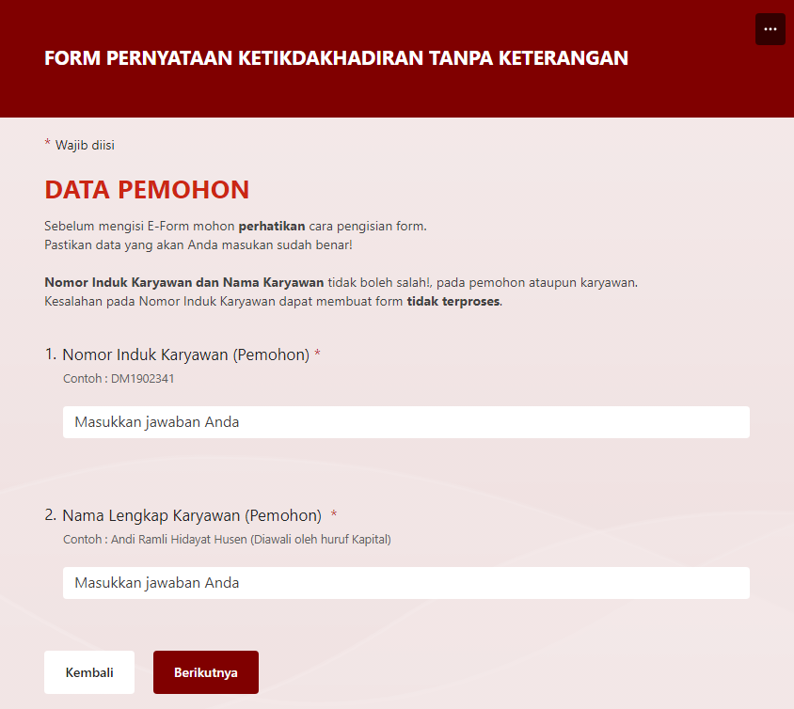
DETAIL SYSTEM
FLOW PROCESS
ADVANTAGES FORM
NOTIFICATION
All employee as a requester get notification from their Personal Account Mail
Paper Form can make More Costs For Company
Requester
Spent 500 Paper
Input data Form on paper
Admin
(HRGA)
Notification
Admin
( Section )
Processing
By Office Phone
Approver
Walking Time 10 minutes
Request Approval
AUTO FILL INPUT
Some system we create in Power Apps and We Connect to local Database make the Application Auto fill employee data when we just Input our NIK
PAPER FORM
DIGTAL FORM
FLEXIBLE ACCESS
Some system we create in
MS Form so that it can be accessed by all employees and of course it can be accessed Anywhere and Anytime.
Approval Everywhere and Every time with MS Teams
Requester
Zero Paper Usage
Input data Form on Device
Admin
(HRGA)
Notification
SHS
Processing
By Personal Mail
Approver
0 Minute Walking Time
Request Approval on Mail
With Digital Form can Reduce Man Hour & Paper Usage
PT. DENSO MANUFACTURING INDONESIA
DIGITIZING SYSTEM TO IMPROVE EFFICIENCY IN AN EASY, FAST, AND CHEAP WAY
System Development
2/4
@ DENSO CORPORATION All Rights Reserved.
Notes:
detail system, every form have same flow there is

Slide 12

SHS
Smart HR GA System
HR GA FORM
BACK
16 FORM
are still paper-based
4 FORM digital
in HRSS
Mutation Form
Office Access Form
Independent transportation allowance registration form
Salary Correction Form
ID Card Replacement Form
Document Request Form
Permit Work Leave Form
Absence Statement Without Explanation Form
Holiday Work Request Form
Day Change Request Form
Training Report Form
Work Permit Outside Form
Own Motor Vehicle Form
Claims For Official Travel Expenses by Private Vehicle
Registration Of Independent Transportation Allowance Form
Vehicle Lending
Form Overtime Request
Form MBO
Form Manpower Request
Form Appraisal
PT. DENSO MANUFACTURING INDONESIA
System Development
@ DENSO CORPORATION All Rights Reserved.

Slide 13
SHS
Smart HR GA System
HR GA FORM
BACK
Form Name | Case / Month | Paper Usage
Mutasi
Akses office
Permintaan kerja di hari libur
PT. DENSO MANUFACTURING INDONESIA
System Development
@ DENSO CORPORATION All Rights Reserved.

Slide 14
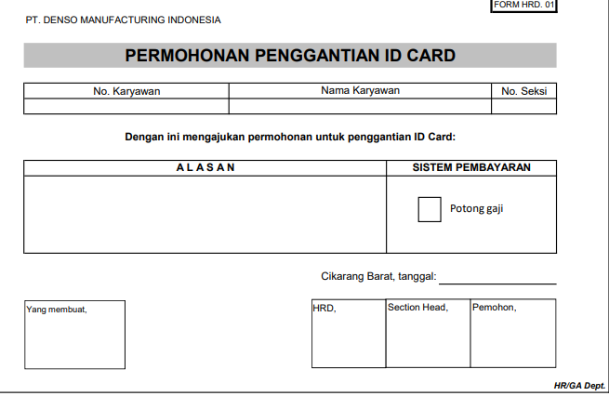


IMPROVE HRGA EFFICIENCY BY SMART SYSTEM
TARGET
3
Efficiency Operation with Digital System
SHS?
Digitalize 8 form
Reduce paper 1080 paper & saving man hour 540 minutes / month
Easy Track and Monitoring with Visualization
Digitalize system that possible in Power Platform
WAY OF
THINKING
Digitalize System at HRGA
Digital
GOALS
100%
One Stop
Service
CURRENT CONDITION
1
ACTIVITY
4
B. HR (OPERATION)
Create :
E-Vehicle Lending
E-Change Day
16 Form still Paper Based
Spent 25920 paper / Year
E-Document Request
E-Employee Absence
E-Holiday Work Request
E-ID Card Replacement
CLICK DETAIL
Difficult Tracking and Monitoring Employee Request
Improve : 7. E-Mutation 8. E-Access
A. USER (LOST TIME)
20 Minutes
5
Minutes
High-Cost Development and Maintain with Vendor
1 Form = 25 Million
Create Visualization Dashboard to all Form that will digitalize with Power Platform
Walking Approval
Prepare Paper
PURPOSE
2
Socialization and Submission
SHS to HRGA Team for Citizen Developer Maintain
Create Digital System to Eliminate User Lost Time
Create Digital System to Improve HR Efficiency
Create Visualization to Track and Monitoring Form
Create system that Low-Cost Development without Vendor and Easy to Maintain for Citizen Developer
14 Aug – 24 Aug
24 Aug – 24 Sept
25 Sept – 13 Oct
6, 19, .. Oct
25 Oct
CONCEPT
DEVELOPMENT
USER ACCEPTED TEST
DEPARTMENT HEAD REVIEW
PRESENTATION
DIGITIZING SYSTEM TO IMPROVE EFFICIENCY IN AN EASY, FAST, AND CHEAP WAY
1/4
Notes:
IMPROVE HR EFFICIENCY BY SMART SYSTEM
WITH SMART HRGA SYSTEM WE CAN make OPERATION IN HRGA WILL BE MORE EFFICIENCY, WHY?
LET’S SEE CURRENT CONDITION
In HRGA there's several form, like request id card replacement, vehicle borrowing form request etc, some form that still paper based have manual process, so this make employee as a requester have loss time, there is walking approval arrange 20 minutes and prepare paper arrange 5 minutes.
And until now in HRGA 16 Form are still paper based, its mean spent 25920 paper yearly.
HRGA also difficult to track and monitoring form because there are paper
And then if they are want to Digitalize form they must pay vendor 25 million for 1 form to Create and Maintain
So with this condition SHS purpose to
Create Digital System to Eliminate User Lost Time
Create Digital System to Improve HR Efficiency
Create Visualization to Track and Monitoring Form
Create system that Low-Cost Development without Vendor and Easy to Maintain for Citizen Developer
and then our targets in 2 months is
1-4
And following of the target there is our activity

Slide 15
DETAIL SYSTEM
FLOW PROCESS
ADVANTAGES FORM
NOTIFICATION
All employee as a requester get notification from their Personal Account Mail
Paper Form can make More Costs For Company
Requester
Spent 500 Paper
Input data Form on paper
Admin
(HRGA)
Notification
Admin
( Section )
Processing
By Office Phone
Approver
Walking Time 10 minutes
Request Approval
AUTO FILL INPUT
Some system we create in Power Apps and We Connect to local Database make the Application Auto fill employee data when we just Input our NIK
PAPER FORM
DIGTAL FORM
FLEXIBLE ACCESS
Some system we create in
MS Form so that it can be accessed by all employees and of course it can be accessed Anywhere and Anytime.
Approval Everywhere and Every time with MS Teams
Requester
Zero Paper Usage
Input data Form on Device
Admin
(HRGA)
Notification
SHS
Processing
By Personal Mail
Approver
0 Minute Walking Time
Request Approval on Mail
With Digital Form can Reduce Man Hour & Paper Usage
WITH DIGITAL SYSTEM BEING MORE EFFECTIVE, PRODUCTIVE, ………………………
2/4
Notes:
detail system, every form have same flow there is

Slide 16





SHS
IMPROVE HRGA EFFICIENCY BY SMART SYSTEM
Smart HRGA System
PURPOUSE
Create Digital System to Eliminate User Lost Time
Create Digital System to Improve HR Efficiency
Create Visualization to Track and Monitoring Form
Create system that Low Cost Development without Vendor and Easy to Maintain for Citizen Developer
Efficiency Operation with Digital System
GOALS : 100% Digitalize System at HRGA
SHS : Digital One Stop Service
\PENJELASAN -> all employee needs are in one platform
\\GAMBAR ->
\\\
TARGET
Reduce paper….. saving man hour…
Digitalize 8 form
Visualize digital form in one system
Digitalize system that possible in power platform
CURRENT CONDITION
\USER
LOST TIME -> Walking Approval & Prepare Paper
\HR
16 Form still Paper Based
Difficult Tracking and Monitoring Employee Request
High Cost Development and Maintain with Vendor -> 1 Form 25 Million
ACTIVITY
Create
E-Vehicle Lending
E-Change Day
E-Holiday Work Request
Improve E- E-
Create Dashboard
Socialization and Submission SHS to HRGA Team
PT. DENSO MANUFACTURING INDONESIA
DIGITIZING SYSTEM IN AN EASY, FAST, AND CHEAP WAY
1/4
System Development
Development
Department Head Review
@ DENSO CORPORATION All Rights Reserved.
2 MONTH
Concept
User Accepted Test
Presentation

